Slide 1
Introduction to Python
Ipshita; Tom Joy; Owais Hussain

Slide 2
Contents
What is Computer Programming?
What is Python?
Jupyter Notebooks
Variables
Data Types
Operators
Expressions
Logic
Loops
Data Structures
Functions
Classes

Slide 3
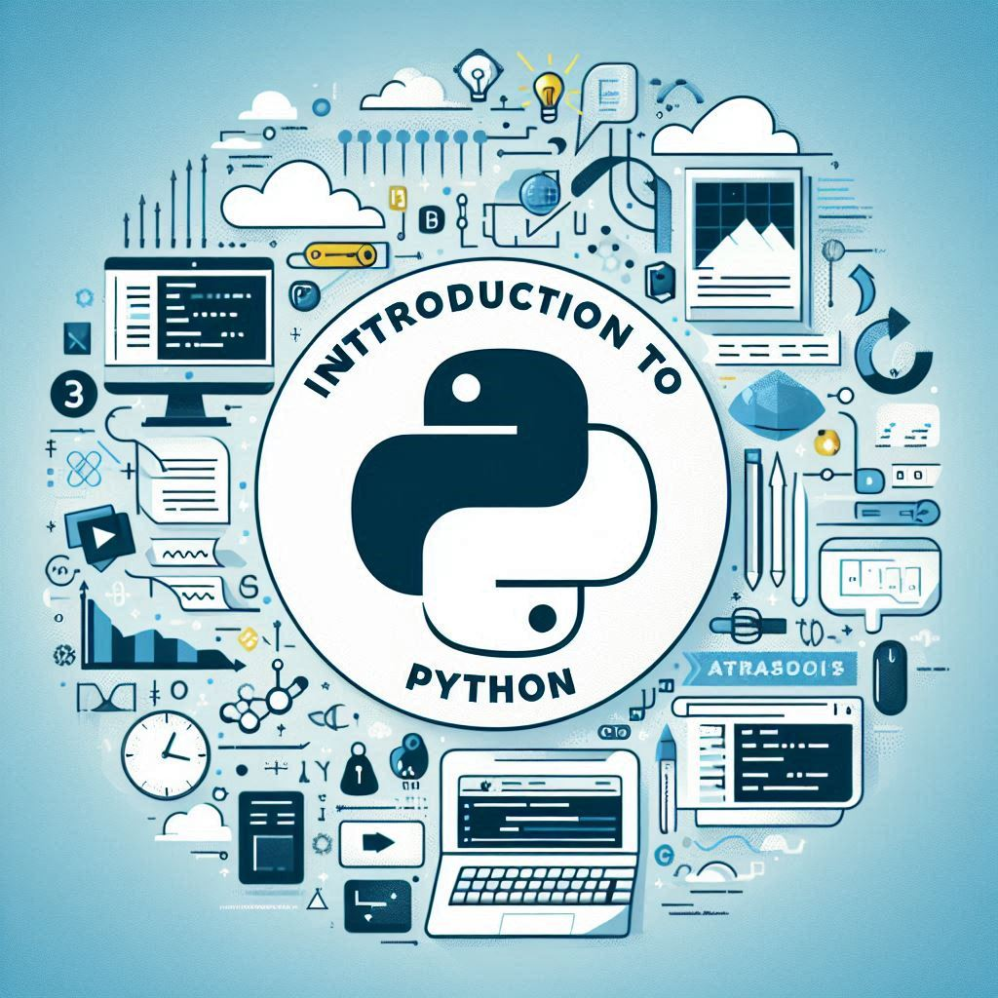
What is Computer Programming?
Ever wondered how your Instagram magically know what you’d like to see next?
It’s computer code whispering to Instagram “Hey, she liked the random clip from that Korean drama; she also watched it twice; she did press share button too, so serve her more of that.”
Programmers are the wizards who are writing such magical rules for computers.
Coding is the cheat code to turn “What if…?” into “Look at this!!!” 👾💻
Every single App, Database, AI and website exists because someone programmed it.
3 Steps of Programming
Logic building: you sketch out your grand plans—like an architect drawing blueprints for a skyscraper.
Coding: you roll up your sleeves and start building. You choose your tools—Python, JavaScript, or any coding language—and start turning your blueprint into something real.
Debugging: you hunt down glitches and bust them, ensuring everything works perfectly.

Slide 4
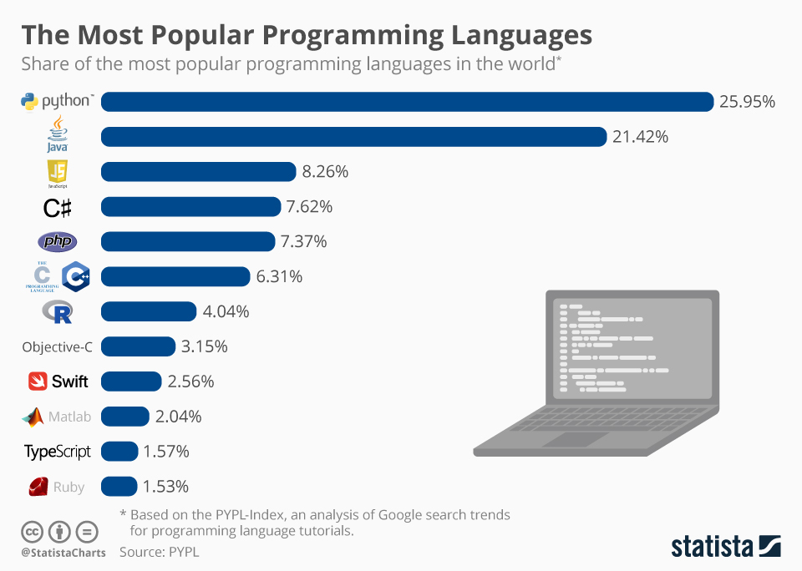
What is Python?
There are lots of programming languages, Python is just one of them.
You can easily get computers to do very complex tasks in a short amount of time.
It’s the most popular language and easy to learn, so it’s worth spending a little bit of time with it.
If you want a career in tech or just want to talk to the bitcoin bros about it, this is a great place to start.

Slide 5
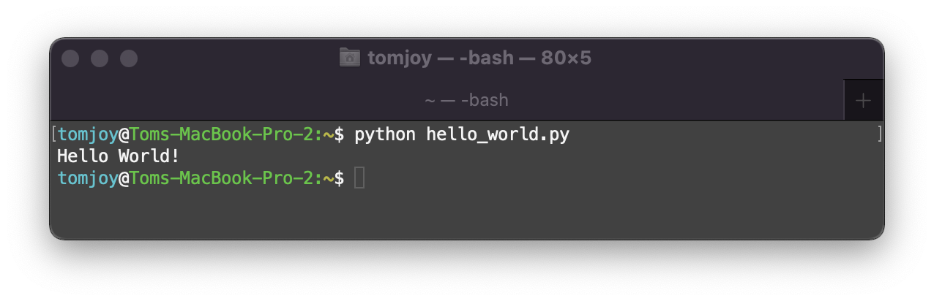

Jupyter Notebooks
Python is normally run from the ‘terminal’, which is the black program you often see hackers using in films.
You can also run them from Jupyter Notebooks, which allows you to run the code without using the terminal.
Notebooks are a lot easier to use and allow you to break the program up.
We will use a more ready-to-ML version of Notebooks, i.e., Google Co-laboratory (Colab).
Simply visit: colab.research.google.com and login with your Gmail account.

Slide 6
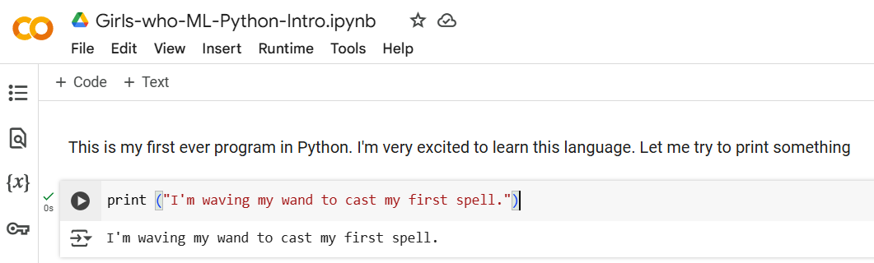
Google Co-laboratory
Getting Started
Create a new notebook and rename it to anything you can remember later (like Girls-who-ML-Python-Intro.ipynb)
There are two types of blocks:
Text: to write notes, To-do’s and explanation of your code
Code: the actual program which will be run

Slide 7
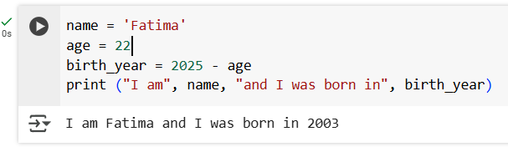
Variables
In programming we need to give objects (number/words/images etc.) names.
We can then access the object using the variable name.
Variable names are Alphanumeric (and underscores) and do not start with a digit.
They are case sensitive. You should prefer small letters.
How to utilize them when printing?

Slide 8
Data Types
We mostly use 4 types of data:
Strings: a sequence of characters. This is used to store text.
Integers: positive and negative whole numbers meant for arithmetic operations.
Decimal: called “Float”, but we’ll discuss this down the road. Float is used to store fractional data.
Boolean: either True or False.
Data | Type
Height in Cm
Current Temperature in degree Celsius
Residential address
National ID number
Allergic to cats?
Date of birth

Slide 9
Operators
We often want to perform operations on variables that are numerical.
Function | Operator
Multiply | *
Add | +
Divide | /
Subtract | -
Power | **
Modulo | %

Slide 10
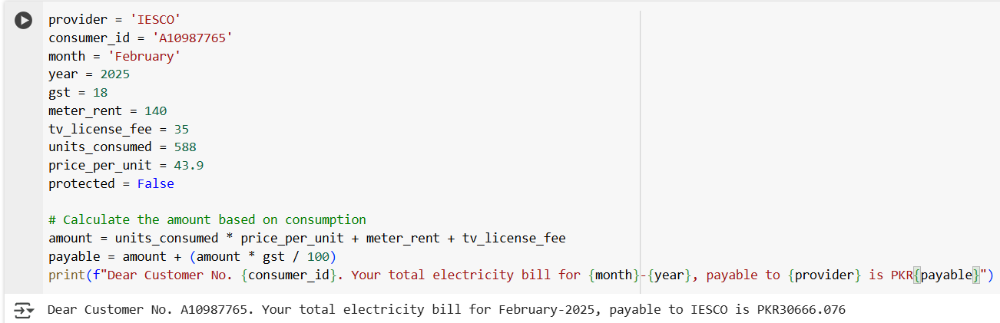
Operators
Calculating electricity bill

Slide 11
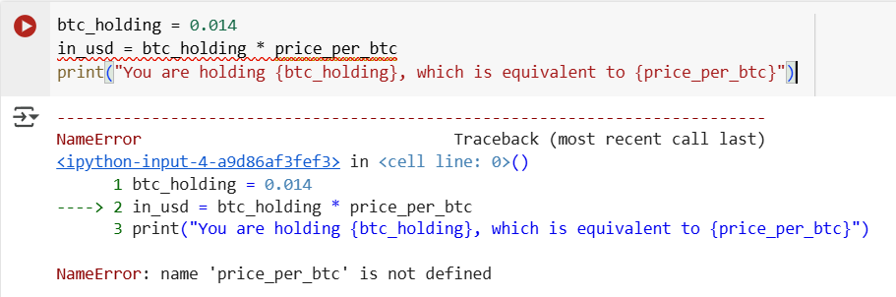
Error Messages
Python will throw an error if there’s an issue with Syntax.
Try and work out the error, but don’t be afraid to Google it!

Slide 12
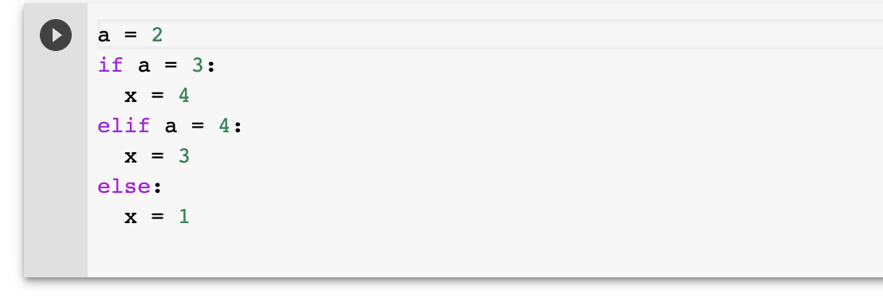
Logic
We can check the value of variables like:
What is the value of x?
Notes:
Tip! There is a BUG in this code. If you’re copying it as-is, you will run into it.

Slide 13
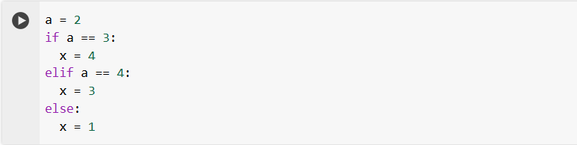
Logic
We can check the value of variables like:
What is the value of x?
Notes:
Tip! There is a BUG in this code. If you’re copying it as-is, you will run into it.

Slide 14
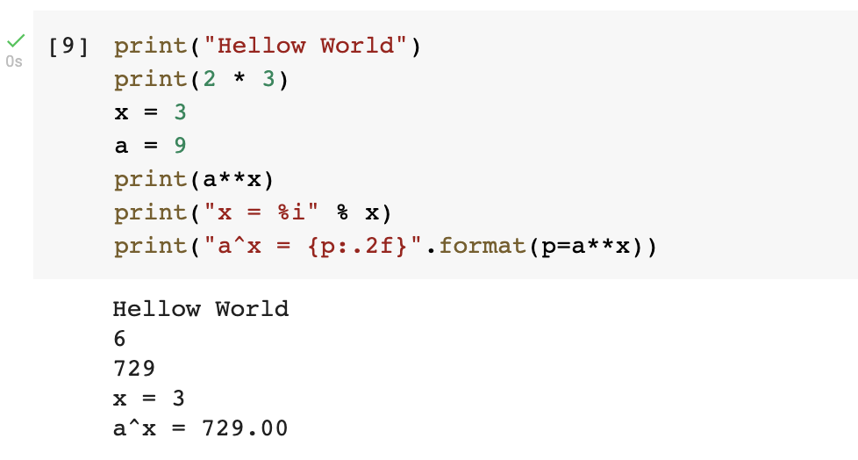
Printing
We can print out the value of variables, this helps when debugging.
There are many ways in which you can print values...

Slide 15
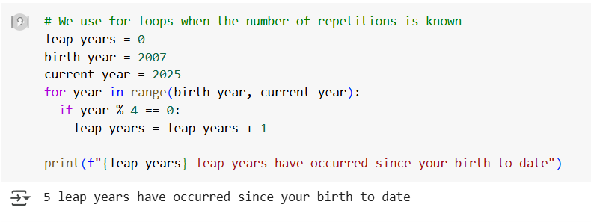
Loops
Sometimes we need to do the same operation multiple times.
We use a “for” loop when the number of repetitions is known.
A while loop is used when the repetitions is not known, but we know when to stop.

Slide 16
Level up
Time to put on your coding hat and challenge yourself with some interesting tasks:
On Google Colab, create a Notebook. Define some variables to provide the following details about yourself:
Your name and age
Your dream car
Car price
Approx. monthly earning
Percentage of earnings that go into saving
Print the values you’ve entered in single statement but separated by lines.
Extend your program to estimate when you’d be able to buy your car.

Slide 17
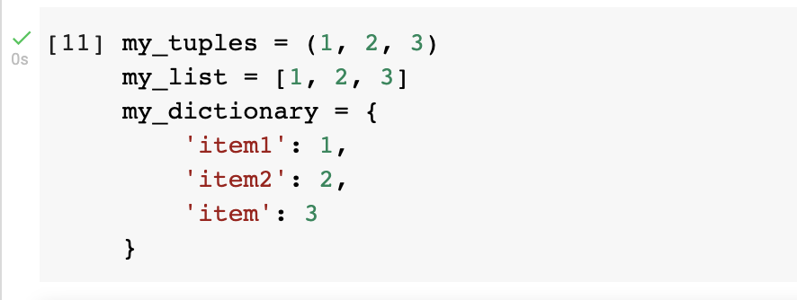
Data Structures
In programming we often need ways to store lots of data, we do this in data structures.
The main ones are: lists [], tuples () and dictionaries {}.

Slide 18
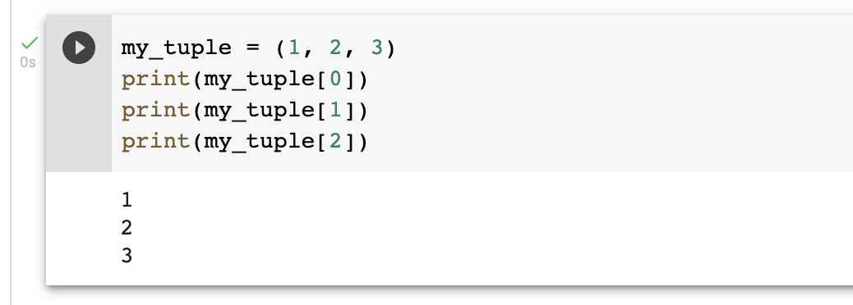
Tuples
Tuples store arrays of data.
We can access elements of the tuples by indexing the tuple.
Tuple values can’t be changed!
We count from 0 in programming, what would the value of my_tuples[3] be?

Slide 19
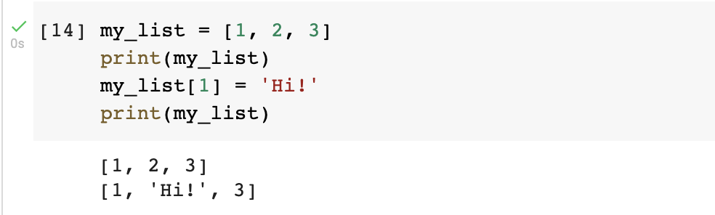
Lists
Lists are like tuples but we can change their values.

Slide 20
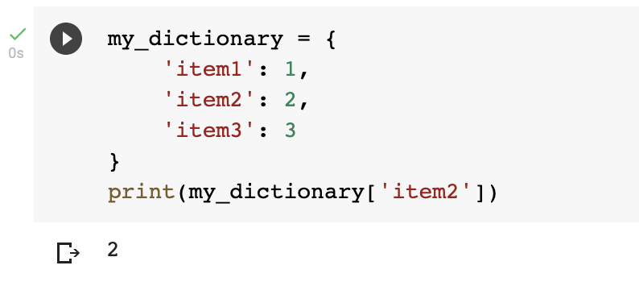
Dictionaries
Dictionaries are stored using a ‘hash table’ and the values are accessed using the key.
They keep data in key-value pairs where key is a string and value can be any object, even another dict.

Slide 21
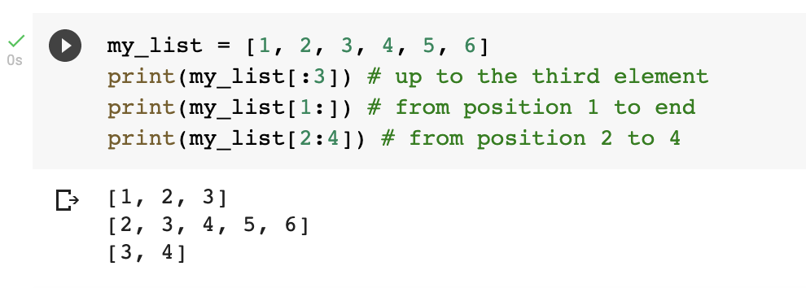
Slices
We can access ranges of lists.

Slide 22
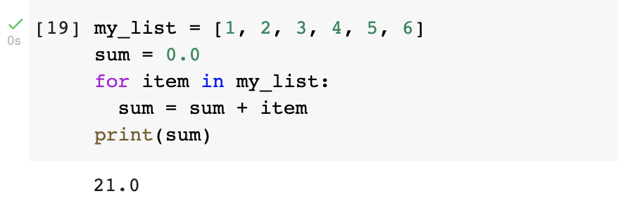
Loops (again)
Adding numbers in a list.

Slide 23
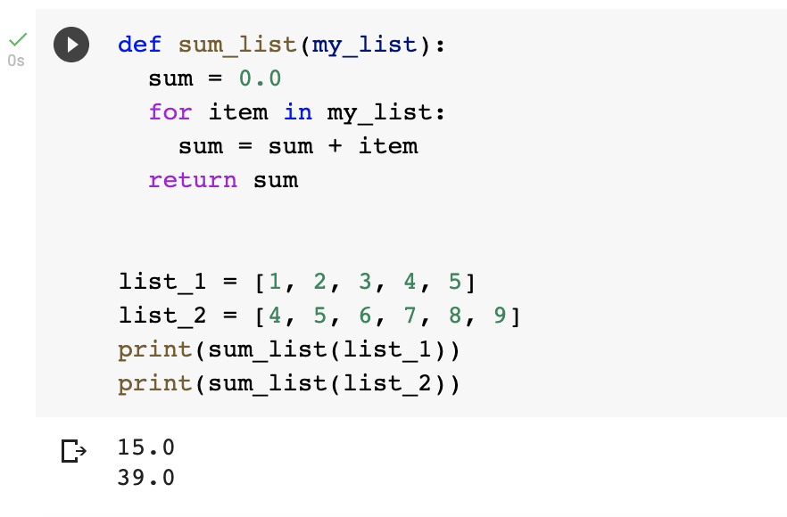
Functions
Functions make life a lot easier when writing lots of code.
It allows us to separate out pieces of the codebase.
If you’re going to do the same set of operations more than twice, it should be a function.

Slide 24
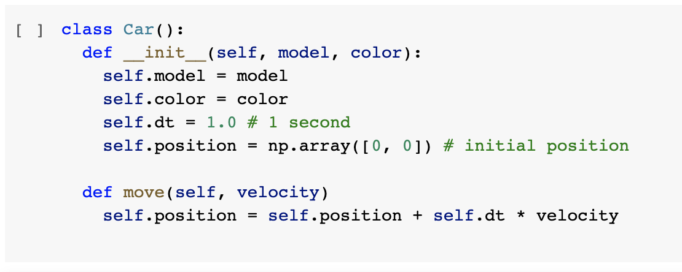
Classes
Classes can be seen as a way to group functions together which act on an ‘abstract’ object.
Think of them as a programming way to describe objects.
This concept may sound a bit complex; it takes and time to understand, so don’t worry too much if you don’t get it straight away.

Slide 25
Classes
Every object needs a constructor. This function is what ‘builds’ the class

Slide 26
Classes
These are member variables of the class
We can update member variables using ‘self’

Slide 27
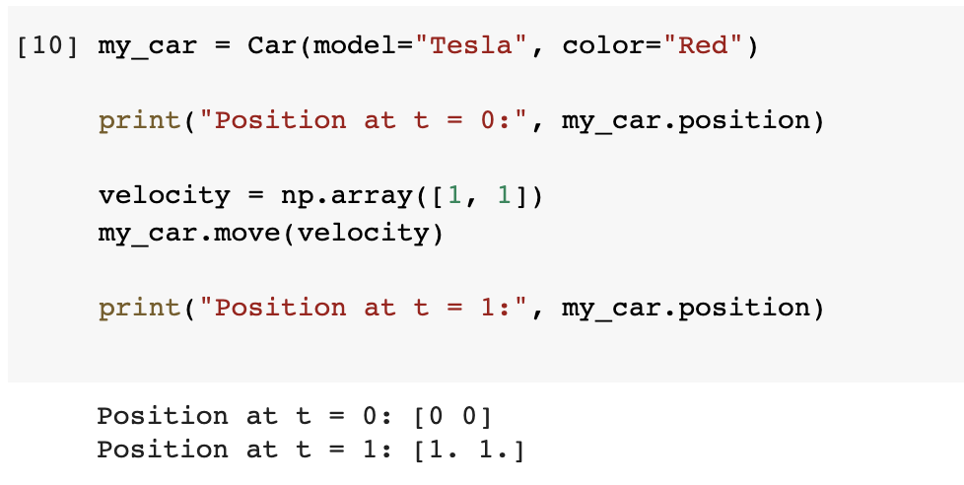
Using classes
Instantiate the class

Slide 28
Using classes
Print out the position

Slide 29
Using classes
Move the car

Slide 30
Using classes
Print out the position

Slide 31
DIY
Write a Python program that takes an integer from the user and prints whether the number is even or odd.
Write a program that takes a number n from the user and calculates the sum of all numbers from 1 to n.
Ask the user to enter 5 numbers. Store these in a list, then print out the largest number.
Write a program that takes a sentence as input from the user and prints out the number of words in that sentence.
Write a program which reads a text file from your computer and prints its contents line by line.
Write a program which searches for a word in a list of words and displays the index of first occurrence.
Write a program which inputs a number and tells whether the number is a Palindrome or not.

Slide 32
That’s it!
We hope this has given you a taste of Python and some idea of what to expect when using it.
DIY: Use ChatGPT’s tutoring ability and create a set of Python exercises for you to sharpen your skills and follow the teaching plan it constructs.
Questions?

